Slide 1
TECHIE
Restaurant Reservation

Slide 2
Full Stack Web Developer
A full stack web developer is a person who can develop both client and server software.
In addition to mastering HTML and CSS, he/she also knows how to:
Program a browser (like using JavaScript, j Query, Angular, or Vue )
Program a server (like using PHP, ASP, Python, or Node)
Program a database (like using SQL, SQLite, or Mongo DB )

Slide 3
Client Software (Front End)
HTML
CSS
Bootstrap
W3.CSS
JavaScript
ES5
HTML DOM
JSON
XML
jQuery
Angular
React
Backbone.js
Express.js
Ember.js
Redux
Storybook
GraphQL
Meteor.js
Grunt
Gulp
Server Software (Back End)
PHP
ASP
C++
C#
Java
Python
Node.js
Ruby
REST
GO
SQL
MongoDB
Firebase.com
Sass
Less
Parse.com
PaaS (Azure and Heroku)

Slide 4
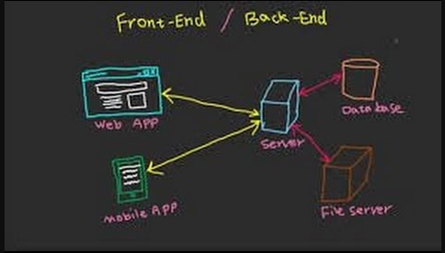

Slide 5

Index

Slide 6
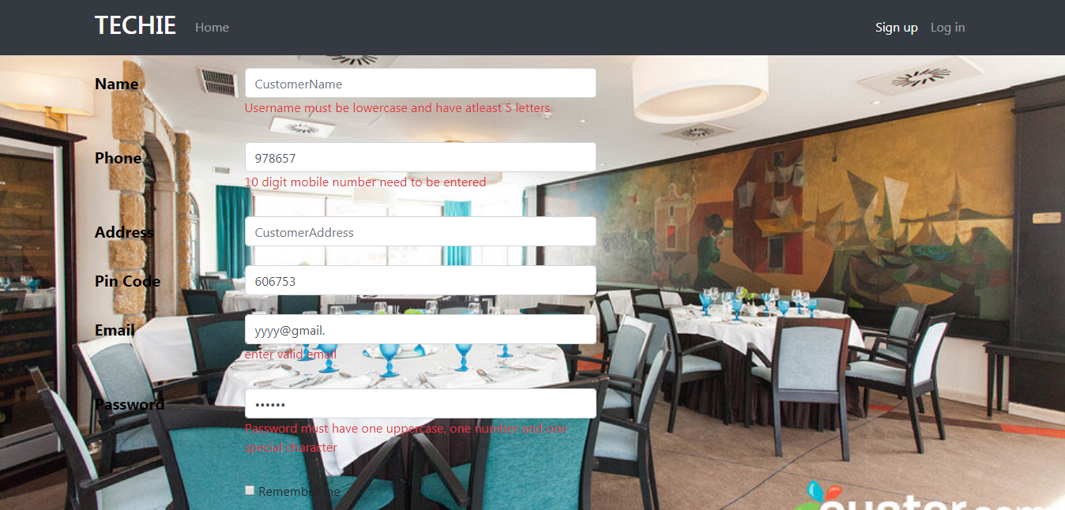
Sign up

Slide 7
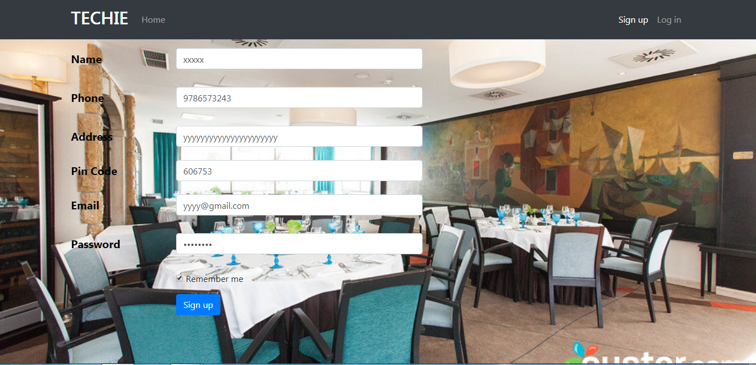
Sign Up

Slide 8
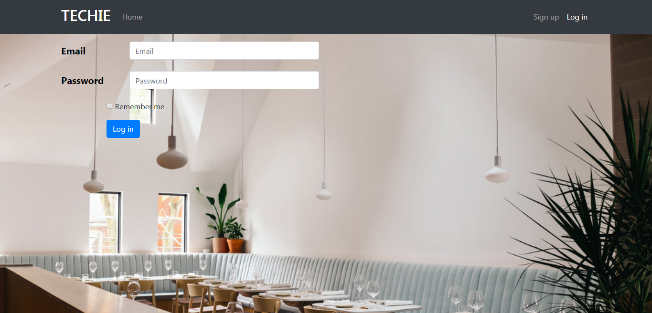
Log In

Slide 9
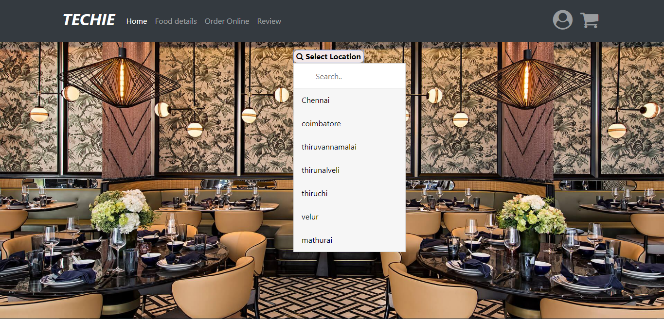
Home

Slide 10
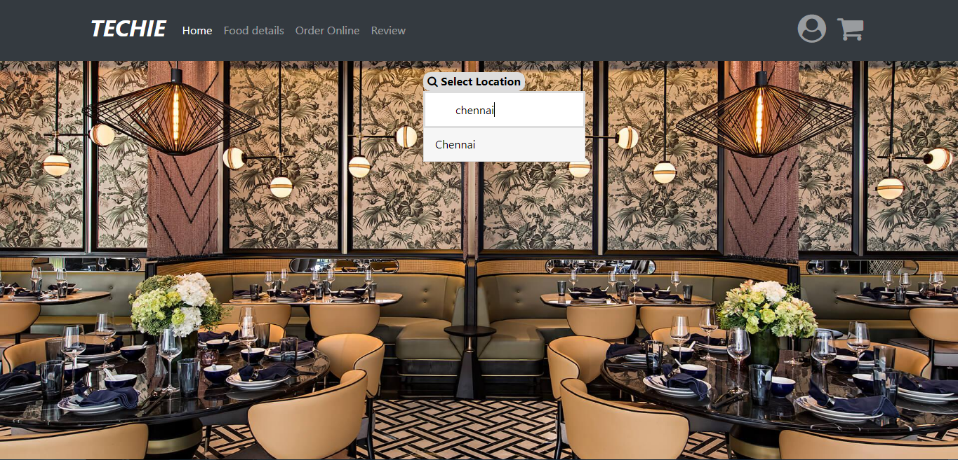
Home

Slide 11

Chennai

Slide 12
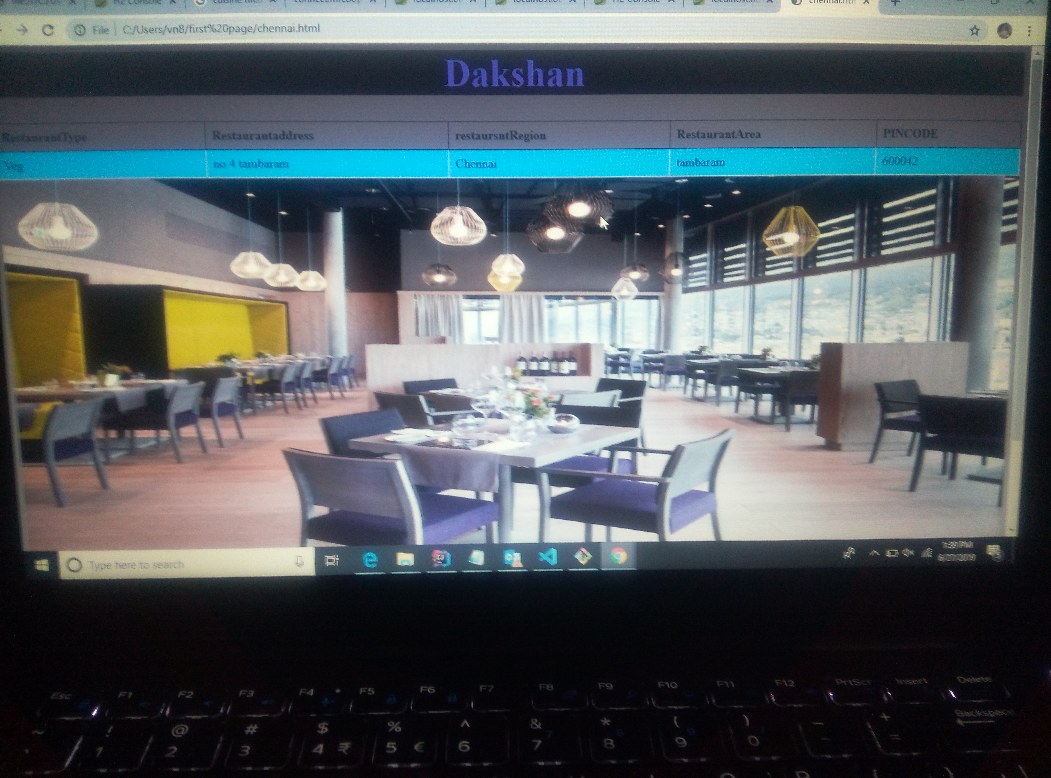

Slide 13
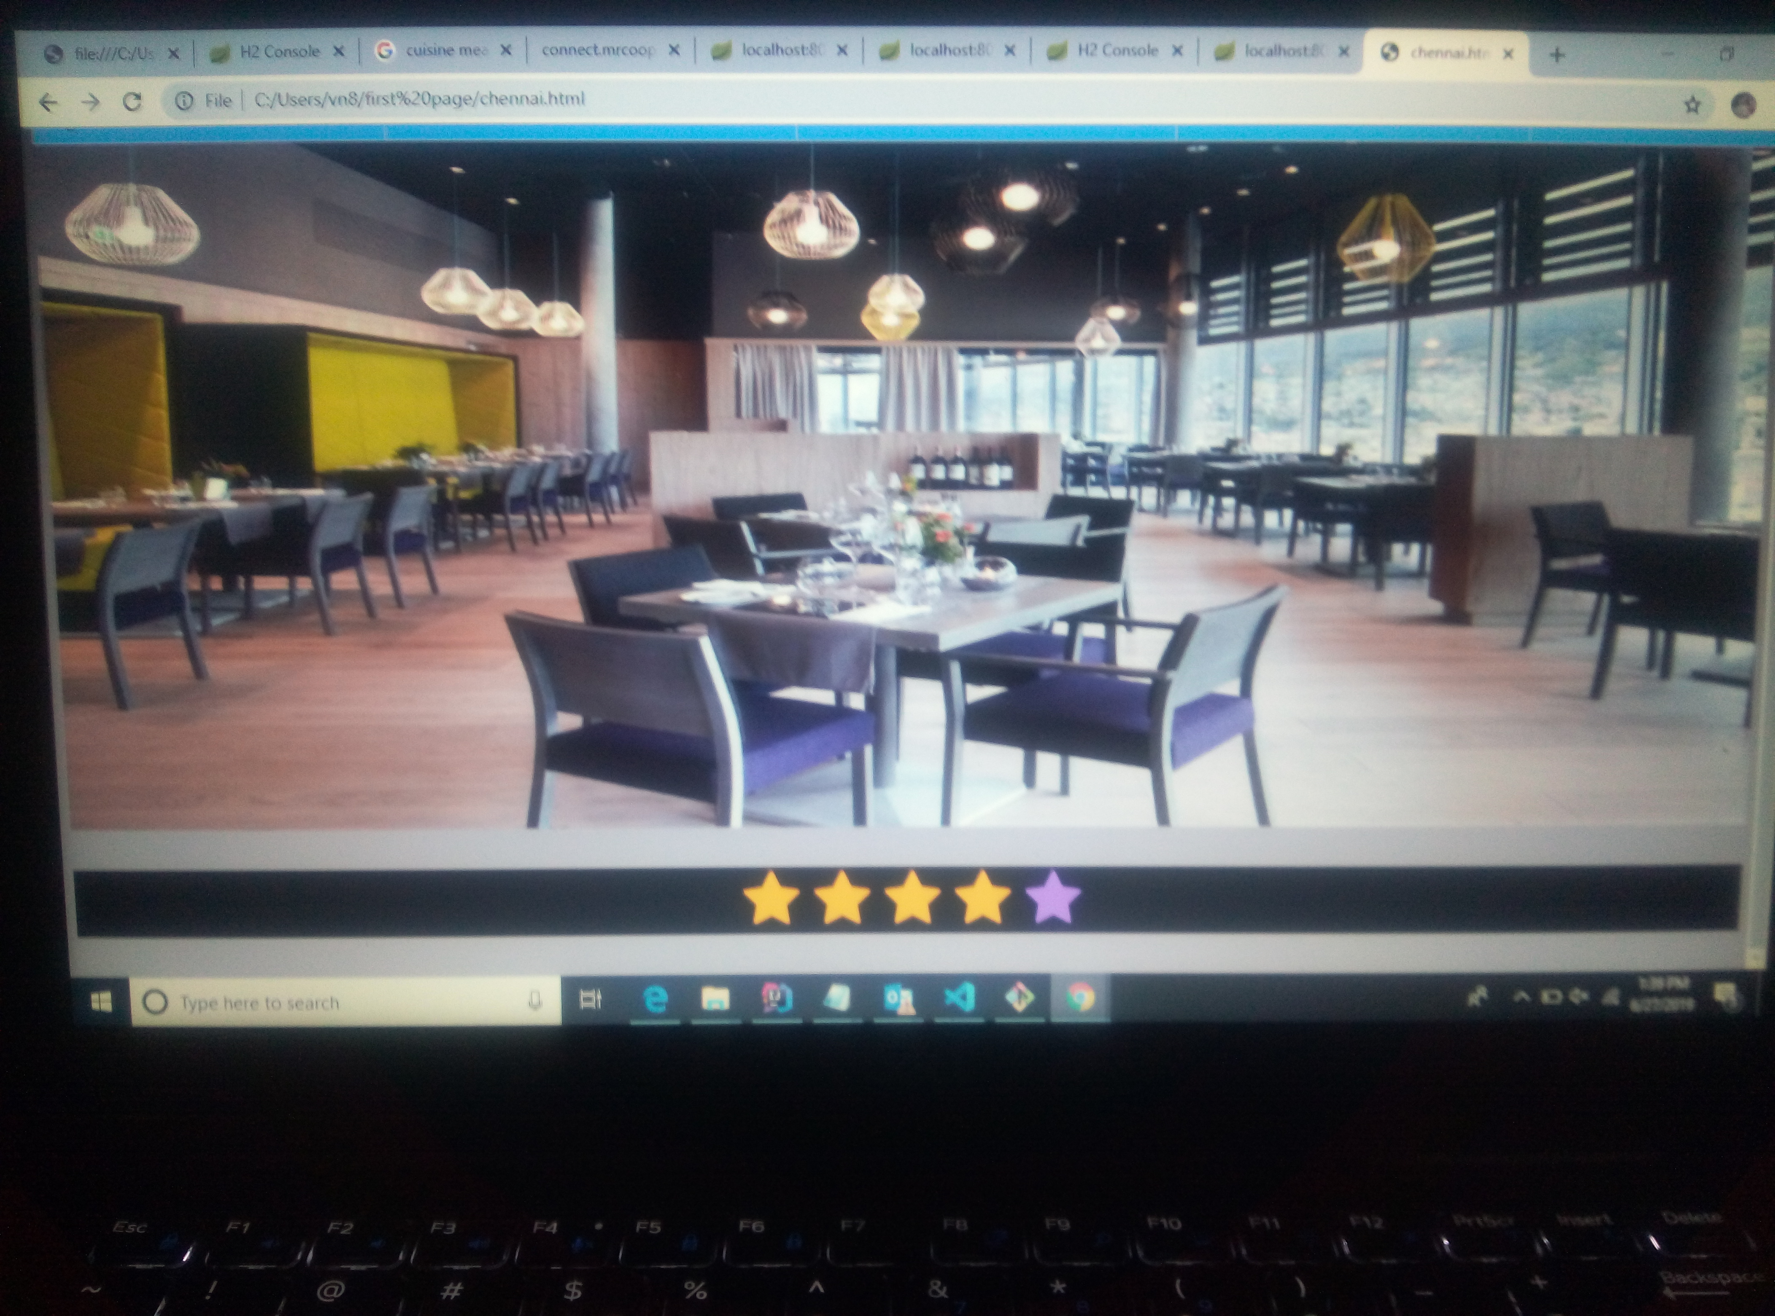

Slide 14
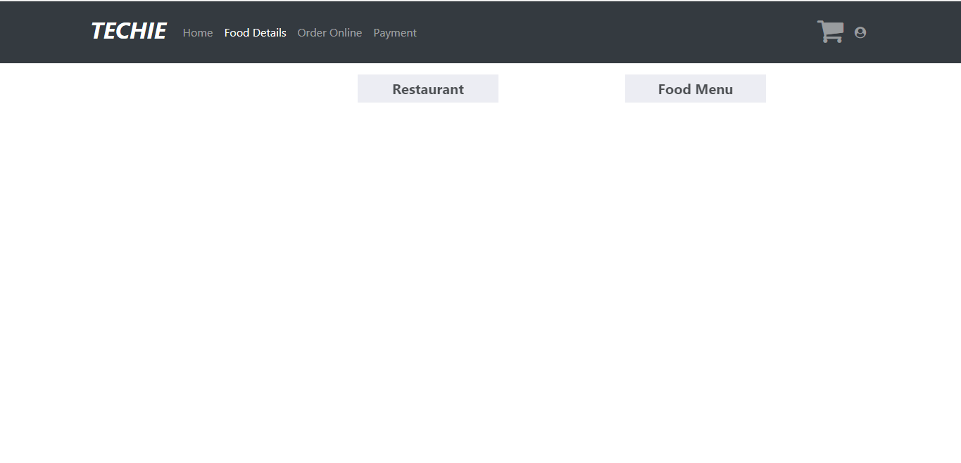
Food details

Slide 15
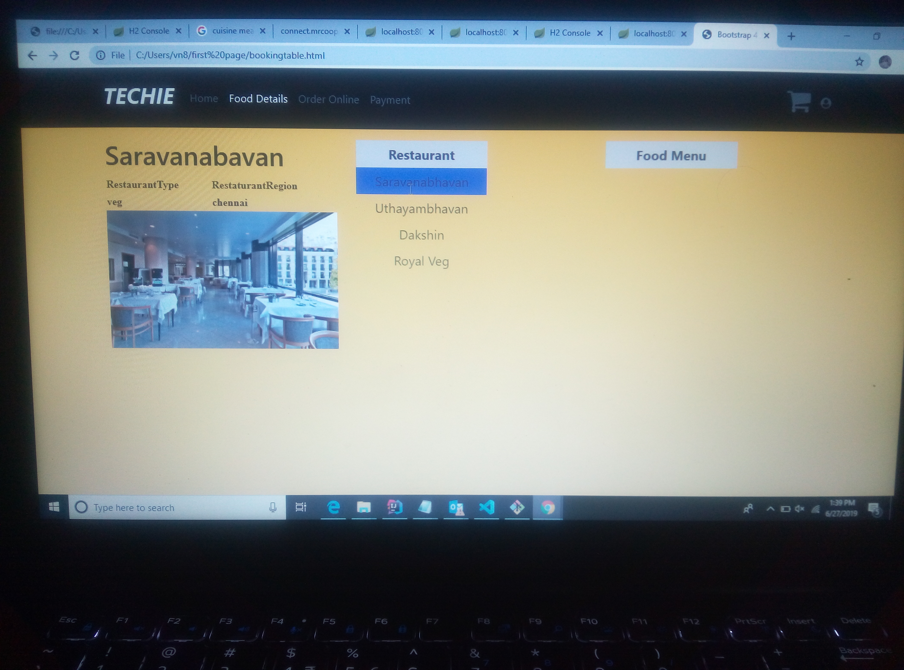
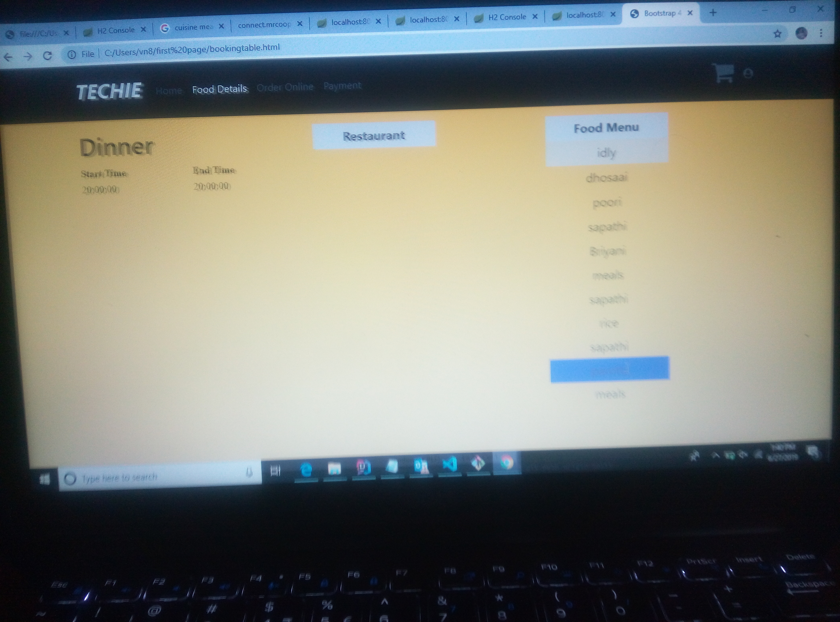
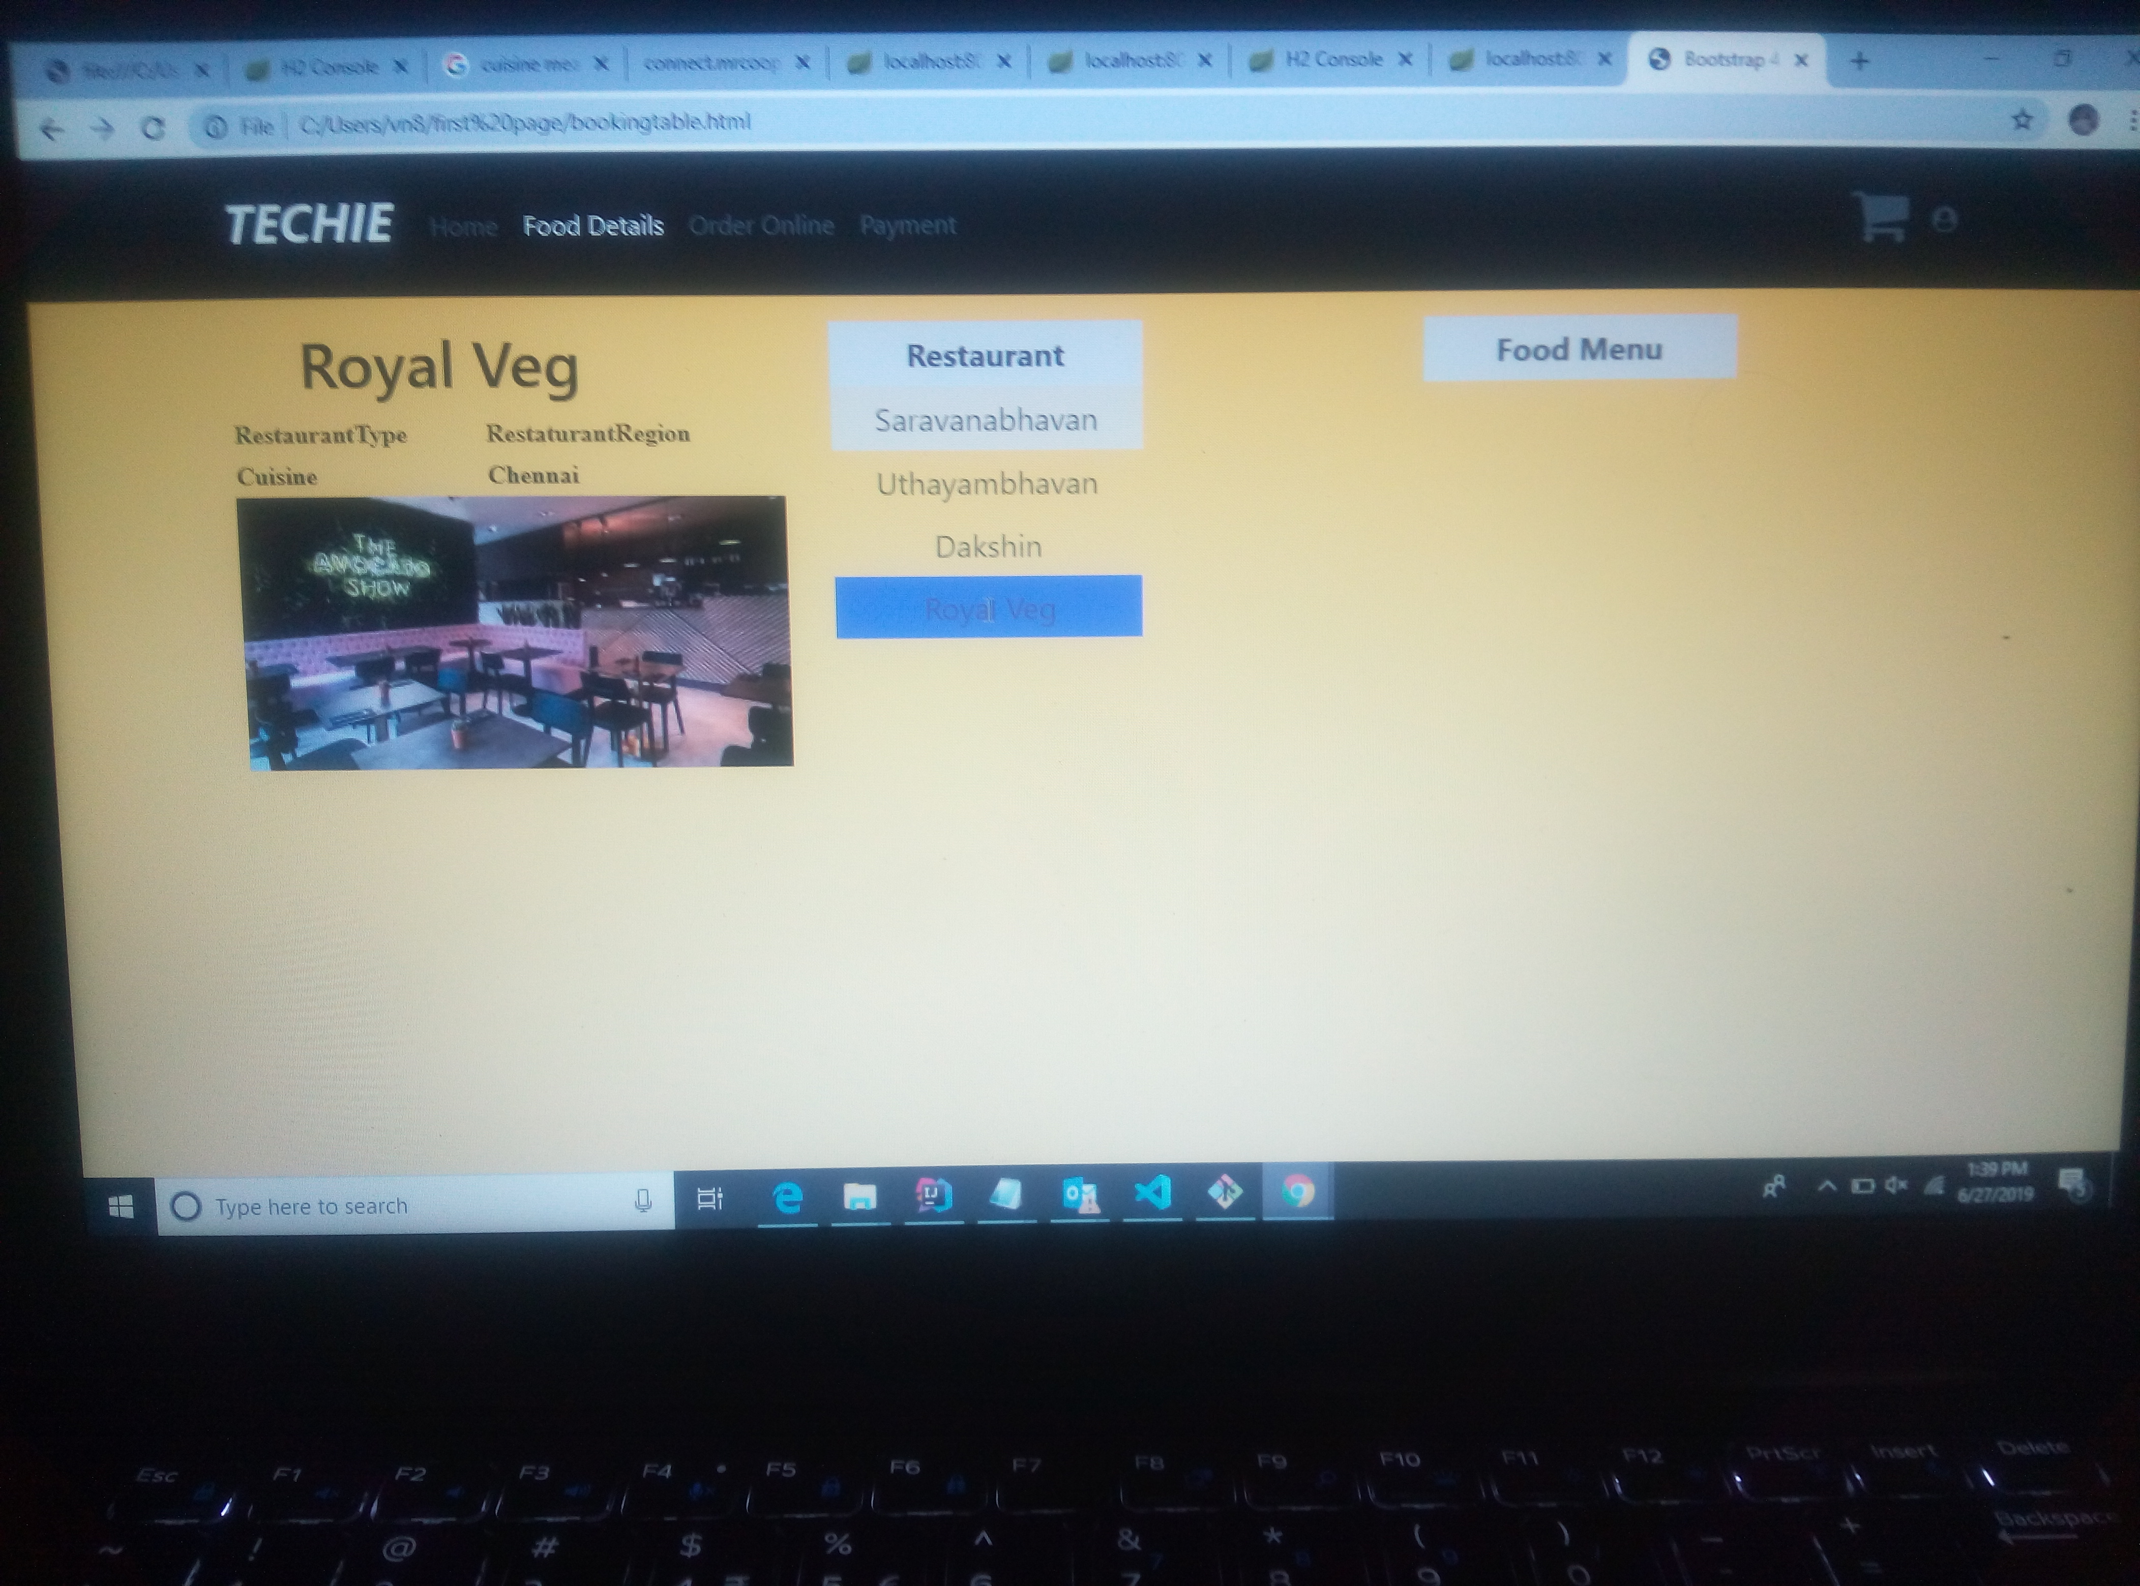

Slide 17
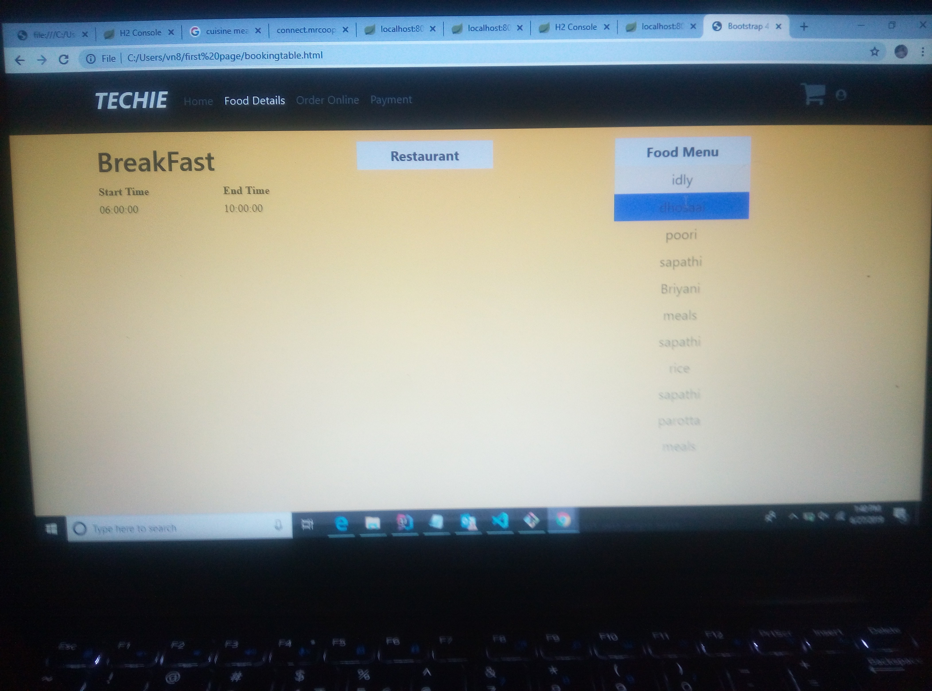
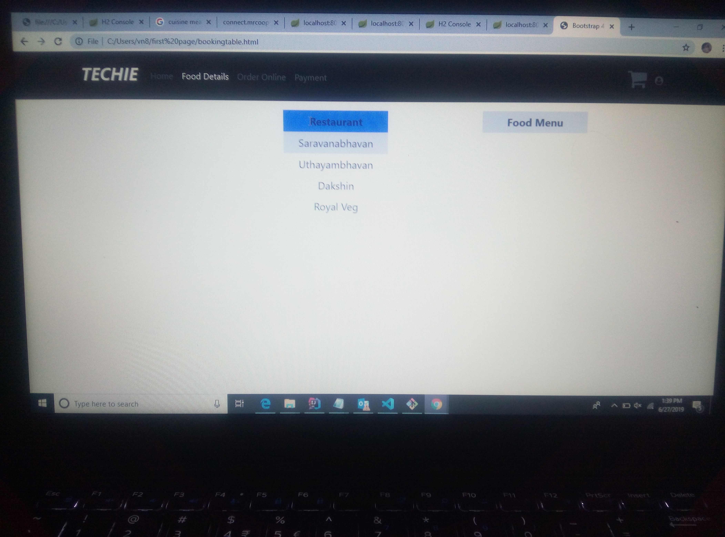

Slide 18
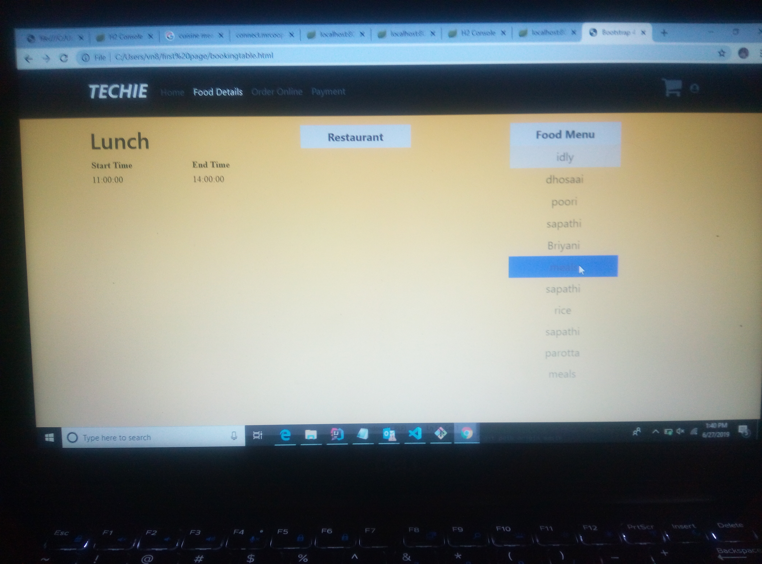

Slide 19
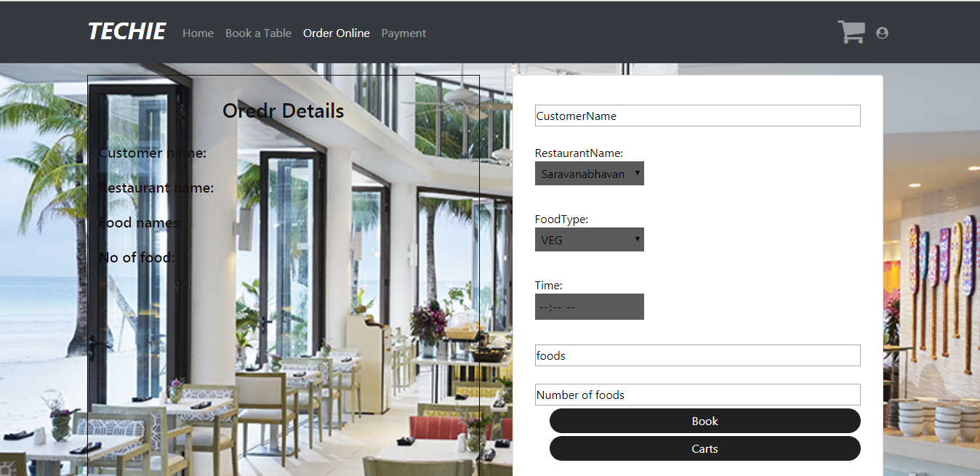
Order Details

Slide 20
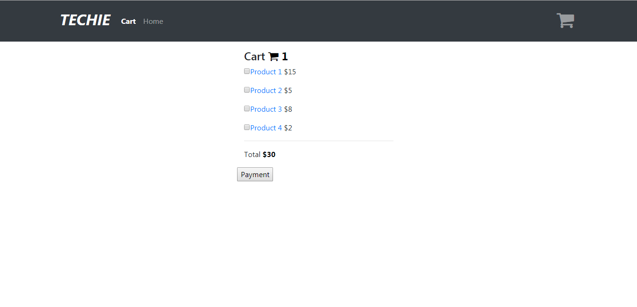
Cart

Slide 21
Cart

Slide 22
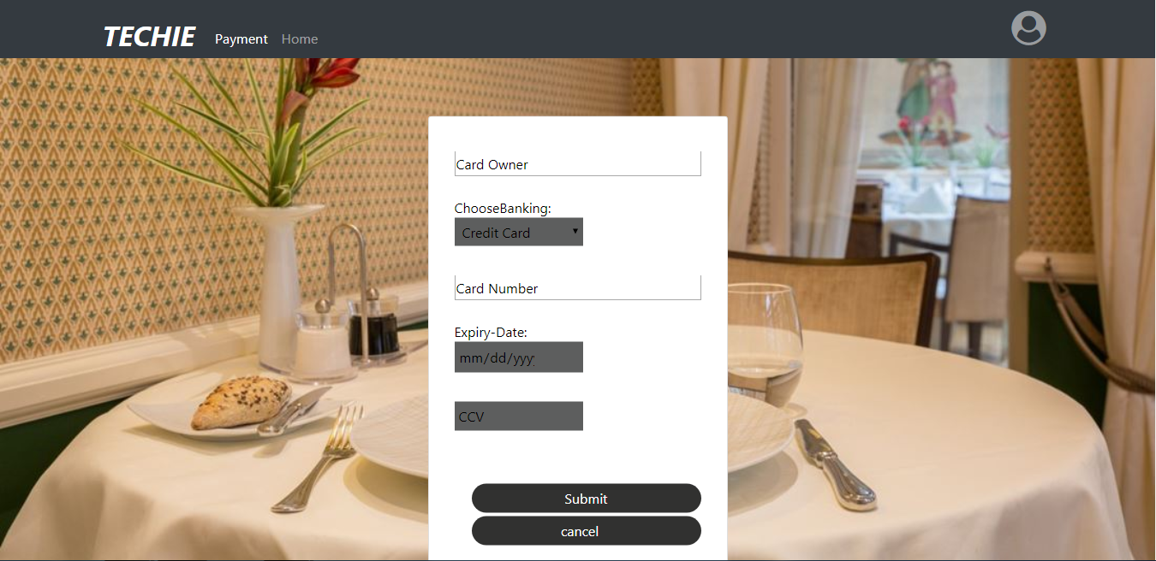
Payment

Slide 23
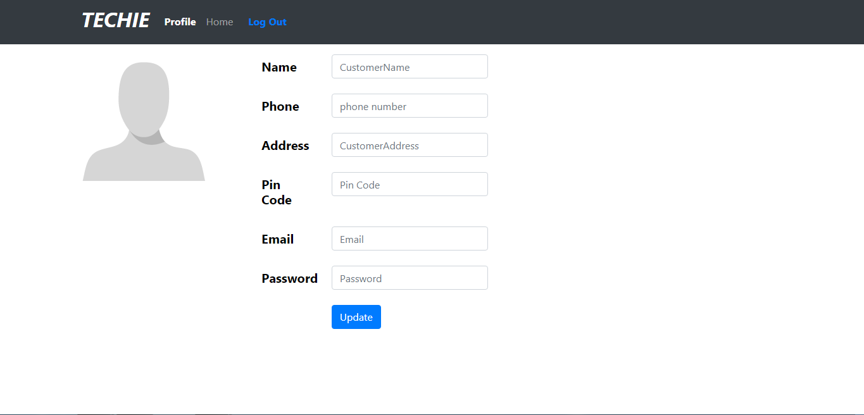
Profile

Slide 24
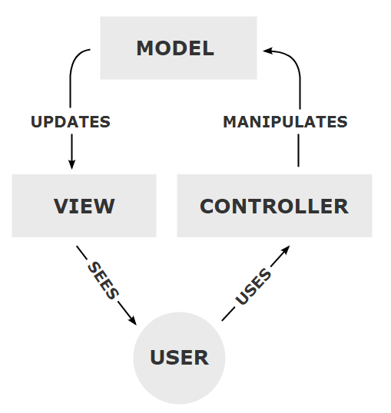
MVC

Slide 25
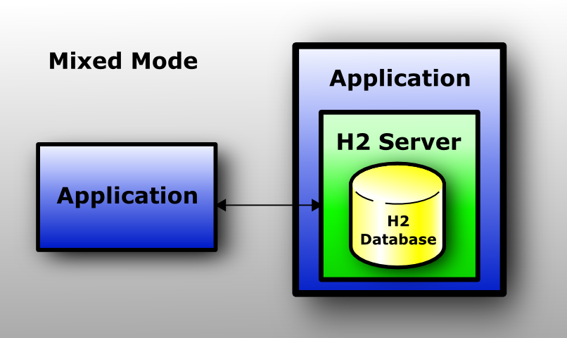

Slide 26
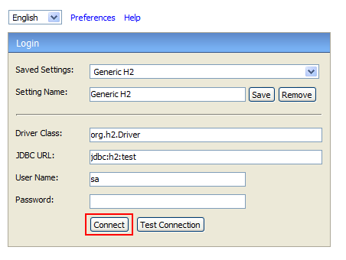
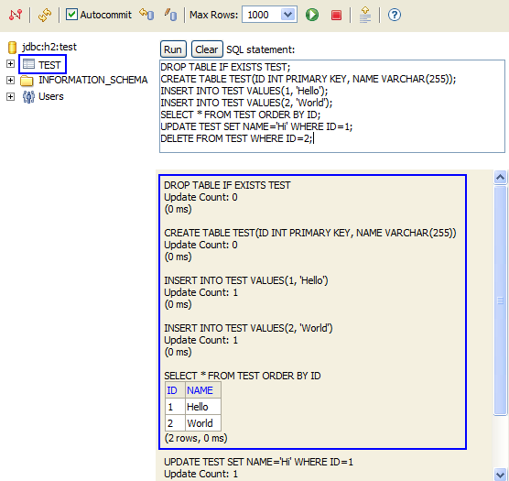

Slide 27
Thankyou

